Slide 1
Points, Vectors, and Matrices
CSCI 4150/6050: Computer Vision

Slide 2
In this course, we are going to talk a lot about image coordinates…
…and I mean a lot.
So let’s make sure we have the basic math down.

Slide 3

Describing Points
How do you describe this point numerically?

Slide 4
Coordinate Systems
y
Origin
x
How do you describe this point numerically?

Slide 5
Coordinate Systems
y
Origin
x
How about this coordinate system?

Slide 6
Coordinate Systems
y
x
Or this one?

Slide 7
Coordinate Systems
y
x
What about this one?

Slide 8
Coordinate Systems
x
Origin
(This is what most
screens use)
y
Why not this?

Slide 9
Coordinate Systems
x
Origin
y
Or this?

Slide 10
Coordinate Systems
x
y
x
y
Math teachers
(“right handed”)
Computer screens
(“left handed”)

Slide 11
Math vs. Code
x
Column
Row
y
How we draw
(x,y)
How we store
(row,col)

Slide 12
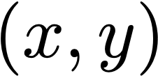
Points
y
x
Points can be described by their Cartesian coordinates.
Coding: use short arrays or n-tuples

Slide 13
Vectors
Describes both the location
And direction unlike points which is only location.
y
x
Vectors can also be thought of
in terms of Cartesian coordinates

Slide 14
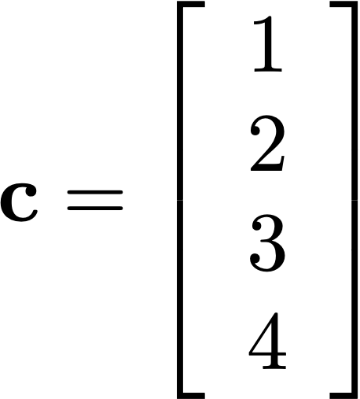
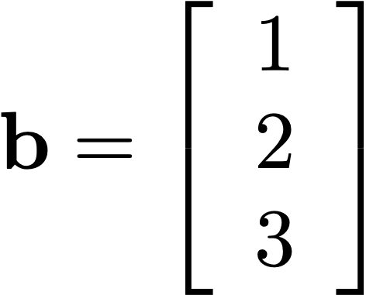
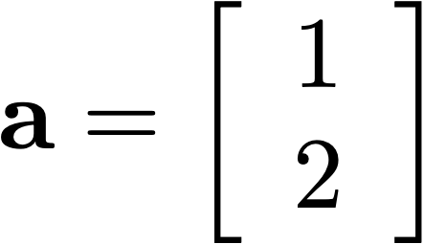
Vectors
Coding: just store in a numpy array

Slide 15
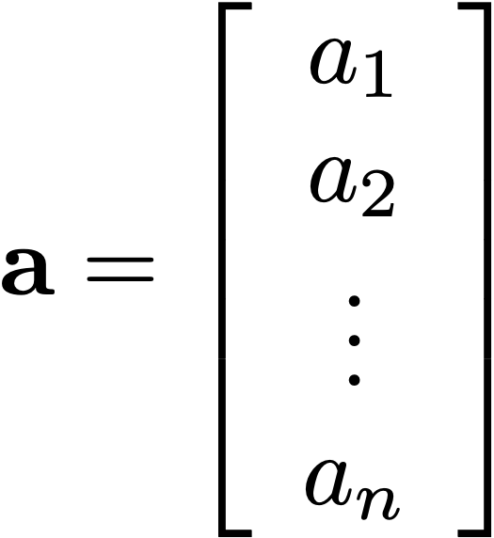
Vectors
Often use subscripts to denote elements of a vector.
Coding: use a[i]

Slide 16
Vectors
Vectors are directional quantities
without a specific location

Slide 17
Points and Vectors
y
The vector has only dirrection
The point has only location
point (x,y)
vector [x,y]
x
Points and vectors are different but related
Interchangeable (but be careful)

Slide 18
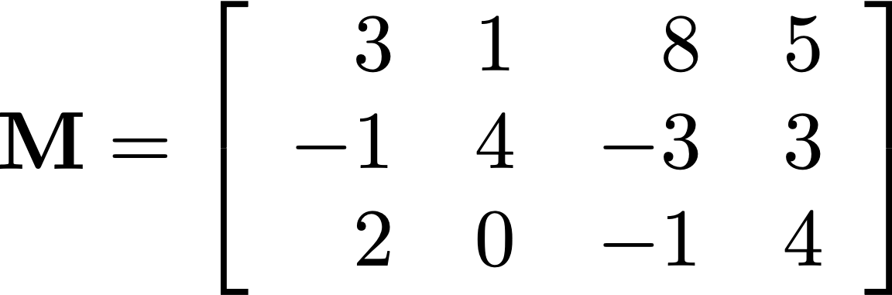
Matrices
A matrix is an n by m array of numbers
Coding: Use a numpy array with multiple []
Example: np.array([[1,2],[3,4]])

Slide 19
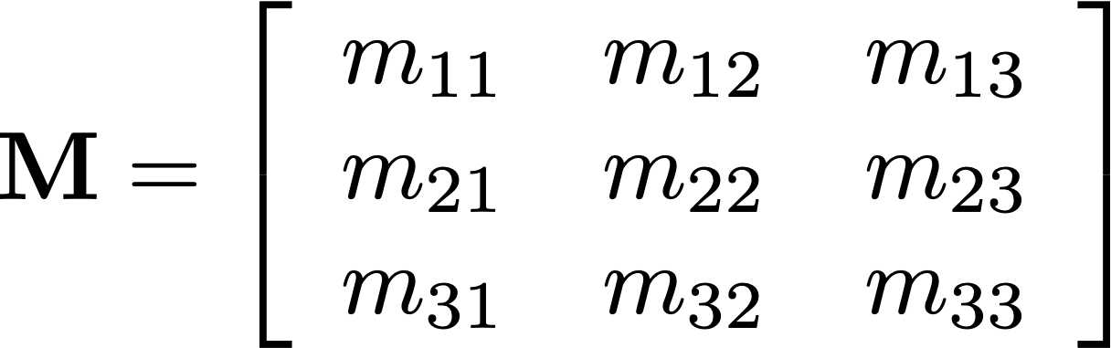
Notation
Index an array by row, then column
Coding: Use a[i,j]

Slide 20
Square Matrices
Diagonal
Square matrices have the same number
of rows as columns (n = m)
If everything off the diagonal is 0,
it is a diagonal matrix

Slide 21
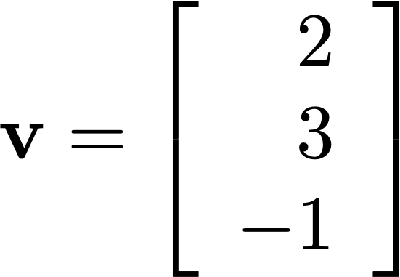
Vectors as Matrices
A vector is simply an n x 1 matrix
(technically, this is a column vector—some use row vectors)

Slide 22
Linear Algebra in this Course
Helpful, but Nonvital
Essential
Vectors
Magnitude
Unit Vectors
Normalization
Dot Products
Orthogonal Vectors
Distance to Point
Vectors
Vector Addition
Commutative Properties
Vector Angles
Cross Products
Additional
slides
available
online
Matrices
Matrix Transpose
Determinant
Matrix Rank
Orthogonal Matrices
Matrices
Matrix Multiplication
Stacked Vectors
Matrix Inversion

Slide 23




Vectors as Displacements
Type system: point + vector = point

Slide 24

Vectors as Displacements
Type system: point - point = vector

Slide 25
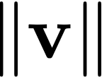


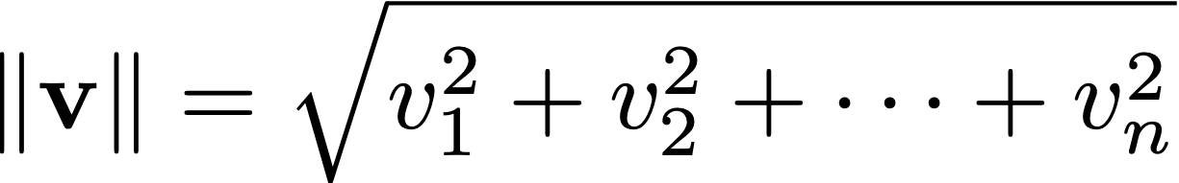
Magnitude
The magnitude (length) of a vector can be calculated using Pythagorean theorem
Sometimes called the norm of the vector
Note: there are other vector norms, but assume this unless stated otherwise
“magnitude”, “length”, or “norm” of v

Slide 26
Distance
Numply: np.lnalg.norm(v)
Convenient way to write / calculate distance between points

Slide 27
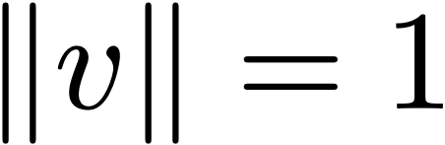
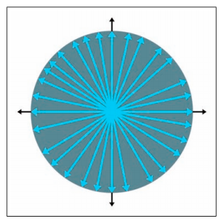
Unit Vectors
A “unit vector” has a length of one
Useful to describe direction when we don’t care about magnitude

Slide 28
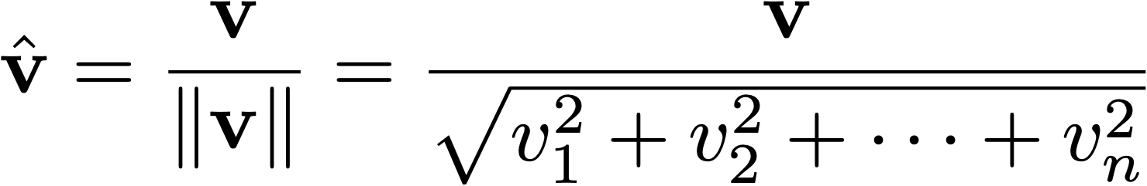
Normalizing
Sometimes we want to normalize a vector to have the same direction but unit length
Key: just divide it by its own length
Can’t do this for the zero vector

Slide 29
Example
$a=\left[\begin{matrix}−3.1 \\ 2.6 \\ −1.4\end{matrix}\right]$
$\left\|a\right\|=\sqrt{{\left(−3.1\right)}^{2}+{2.6}^{2}+{\left(−1.4\right)}^{2}}=4.28$
$\hat{a}=\frac{a}{\left\|a\right\|}=\left[\begin{matrix}−{3.1}/{4.28} \\ {2.6}/{4.28} \\ −{1.4}/{4.28}\end{matrix}\right]=\left[\begin{matrix}−0.72 \\ 0.61 \\ −0.33\end{matrix}\right]$

Slide 30
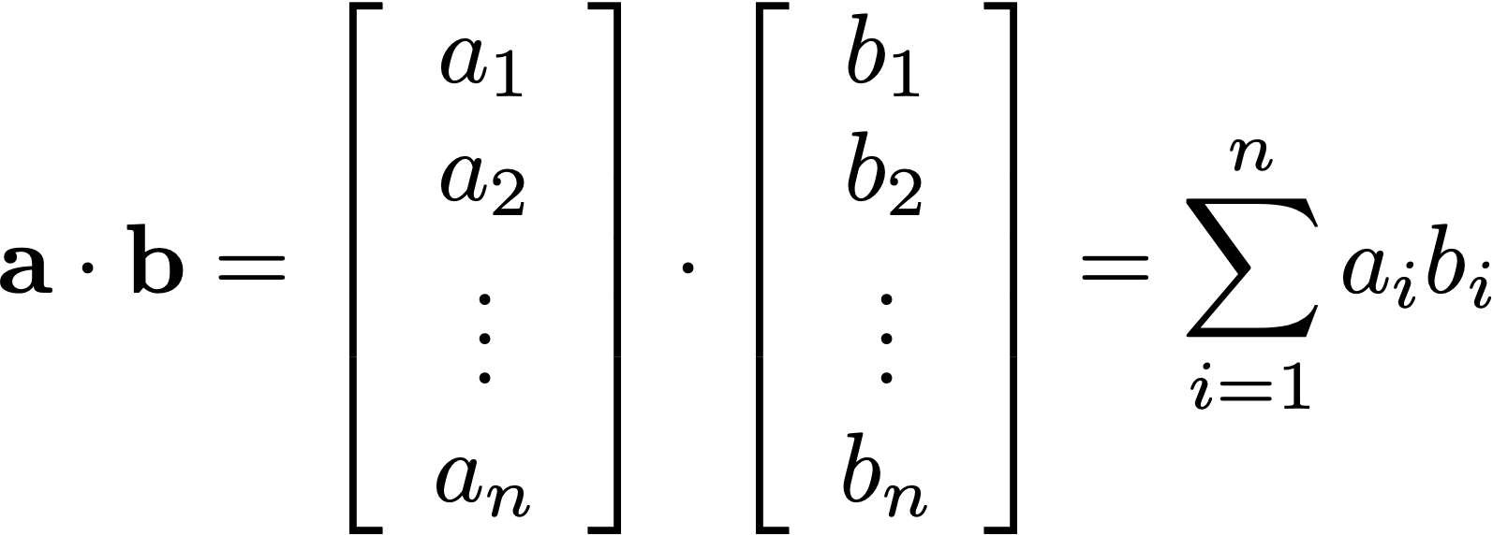
Vector Dot Products
One of the most commonly used
vector operations in graphics

Slide 31
Example
$a=\left[\begin{matrix}−5.1 \\ 7.7\end{matrix}\right]$
$b=\left[\begin{matrix}3.1 \\ 4.5\end{matrix}\right]$
$a∙b=\left(−5.1\right)\left(3.1\right)+\left(7.7\right)\left(4.5\right)=18.84$

Slide 32


Geometric Interpretation
The dot product of a vector and a unit vector
is the length of the projection onto that unit vector
“How much of this vector lies in that direction?”

Slide 33
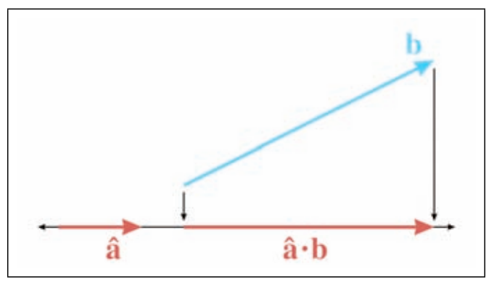
Geometric Interpretation
The dot product of a vector and a unit vector
is the length of the projection onto that unit vector
“How much of this vector lies in that direction?”

Slide 34
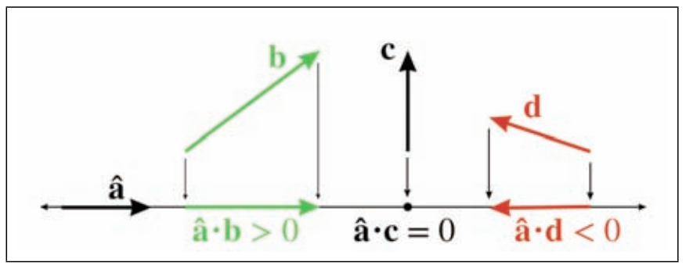
Sign of the Dot Product
The sign of the dot product between two vectors tells
whether the projection is in the same direction

Slide 35
Dot Product Interactives
https://www.learndatasci.com/glossary/dot-product/
https://www.falstad.com/dotproduct/
https://www.geogebra.org/m/Yu6869By

Slide 36


Orthogonality
Vectors whose dot product is zero are said to be “orthogonal”
“Right angle” to each other (regardless of length)
The zero vector is trivially orthogonal to everything else
Orthogonal ie ie perpendicular in 2d

Slide 37
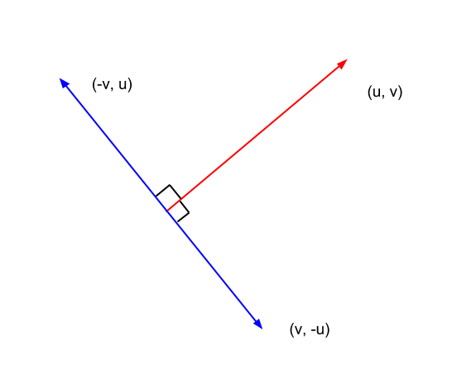
Getting the Perpendicular Vector
Ie getting a perpendicular vector, just flip x and y or u and v
Then negate one. It Is possible only in 2d, other dimensions have many vatiations.
$v=\left[\begin{matrix}x \\ y\end{matrix}\right]$
$v_{\text{⊥}}=\left[\begin{matrix}y \\ −x\end{matrix}\right]$

Slide 38
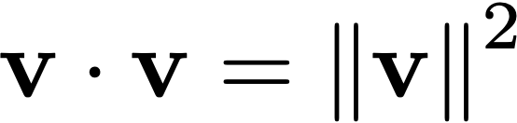
Lengths
The dot product of something with itself
is its own length squared
Tip: lots of “distance” tests only need squared distance

Slide 39
Distance to Point Calculation
P
?
B
A

Slide 40
Distance to Point Calculation
P
B
$v=P−A$
A
$\hat{n}=\frac{B−A}{\left|B−A\right|∨}$

Slide 41
Distance to Point Calculation
P
B
$v=P−A$
C
$C=\left(v∙\hat{n}\right)\hat{n}+A$
A
$\hat{n}=\frac{B−A}{\left|B−A\right|∨}$

Slide 42
Distance to Point Calculation
P
B
d
$v=P−A$
C
$C=\left(v∙\hat{n}\right)\hat{n}+A$
A
$\hat{n}=\frac{B−A}{\left|B−A\right|∨}$
d
N is the normalised vector ie (B-A)/unit vector of (B-A)
d=root of (c1-p1)^2 + (c2-p2)^2
Ie distance between the two vectors.

Slide 43
Example
(3.6, 7.2)
?
(6.8, 8.3)
(-2.1, 1.7)

Slide 44
Example
(3.6, 7.2)
$v=\left[5.7,5.5\right]$
(6.8, 8.3)
(-2.1, 1.7)
$\hat{n}=\frac{\left[8.9,6.6\right]}{\left|\left[8.9,6.6\right]\right|∨=\left[0.80,0.60\right]}$

Slide 45
Example
(3.6, 7.2)
$v=\left[5.7,5.5\right]$
(6.8, 8.3)
C
(-2.1, 1.7)
$C=\left(\left[5.7,5.5\right]∙\left[0.80,0.60\right]\right)\hat{n}+A$
$\hat{n}=\left[0.80,0.60\right]$

Slide 46
Example
(3.6, 7.2)
$v=\left[5.7,5.5\right]$
(6.8, 8.3)
C
(-2.1, 1.7)
$C=\left(7.86\right)\hat{n}+A$
$\hat{n}=\left[0.80,0.60\right]$

Slide 47
Example
(3.6, 7.2)
$v=\left[5.7,5.5\right]$
(6.8, 8.3)
C
(-2.1, 1.7)
$C=\left(7.86\right)\left[0.80,0.60\right]+\left(−2.1,1.7\right)$
$\hat{n}=\left[0.80,0.60\right]$

Slide 48
Example
(3.6, 7.2)
$v=\left[5.7,5.5\right]$
(6.8, 8.3)
C
(-2.1, 1.7)
$C=\left(4.19,6.42\right)$
$\hat{n}=\left[0.80,0.60\right]$

Slide 49
Example
(3.6, 7.2)
$v=\left[5.7,5.5\right]$
(6.8, 8.3)
(4.19, 6.42)
C
(-2.1, 1.7)
$\hat{n}=\left[0.80,0.60\right]$

Slide 50
Example
(3.6, 7.2)
d
$v=\left[5.7,5.5\right]$
(6.8, 8.3)
(4.19, 6.42)
C
(-2.1, 1.7)
$\hat{n}=\left[0.80,0.60\right]$
d

Slide 51
Example
I can use python numpy code for
Practice code.
(3.6, 7.2)
d
$v=\left[5.7,5.5\right]$
(6.8, 8.3)
(4.19, 6.42)
C
(-2.1, 1.7)
$\hat{n}=\left[0.80,0.60\right]$
d=0.98
*Not to scale

Slide 52
Let’s try it in NumPy…

Slide 53
Linear Algebra in this Course
Helpful, but Nonvital
Essential
Vectors
Magnitude
Unit Vectors
Normalization
Dot Products
Orthogonal Vectors
Distance to Point
Vectors
Vector Addition
Commutative Properties
Vector Angles
Cross Products
Additional
slides
available
online
Matrices
Matrix Transpose
Determinant
Matrix Rank
Orthogonal Matrices
Matrices
Matrix Multiplication
Stacked Vectors
Matrix Inversion

Slide 54
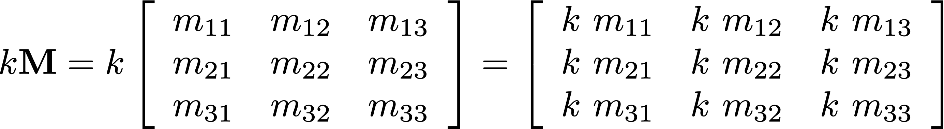
Multiplying by Scalar
Multiply a matrix by a scalar
multiplies each element accordingly

Slide 55

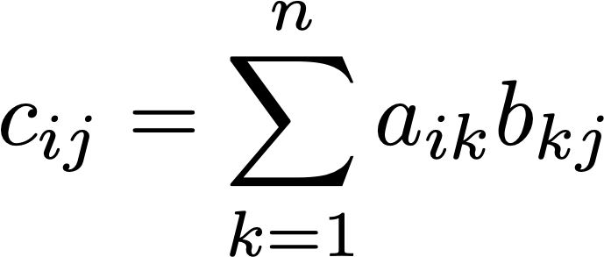
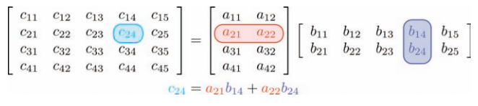
Matrix Multiplication
Ie multiply row by columns.
Look, a dot product!

Slide 56
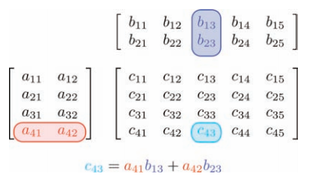
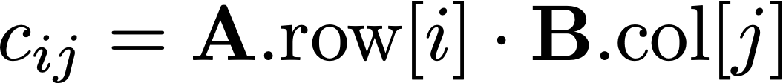
Alternate View

Slide 57
Example
B
$A=\left[\begin{matrix}1 & 2 \\ 5 & 0 \\ 1 & 3\end{matrix}\right]$
AB

Slide 58
Example
B
$A=\left[\begin{matrix}1 & 2 \\ 5 & 0 \\ 1 & 3\end{matrix}\right]$
AB
$c_{11}=a_{11}b_{11}+a_{12}b_{21}=1∙−1+2∙3=5$

Slide 59
Example
B
$A=\left[\begin{matrix}1 & 2 \\ 5 & 0 \\ 1 & 3\end{matrix}\right]$
AB
$c_{12}=a_{11}b_{12}+a_{12}b_{22}=1∙1+2∙2=5$

Slide 60
Example
B
$A=\left[\begin{matrix}1 & 2 \\ 5 & 0 \\ 1 & 3\end{matrix}\right]$
AB
$c_{13}=a_{11}b_{13}+a_{12}b_{23}=1∙0+2∙−2=−4$

Slide 61
Example
B
$A=\left[\begin{matrix}1 & 2 \\ 5 & 0 \\ 1 & 3\end{matrix}\right]$
AB
$c_{21}=a_{21}b_{11}+a_{22}b_{21}=5∙−1+0∙3=−5$

Slide 62
Example
B
$A=\left[\begin{matrix}1 & 2 \\ 5 & 0 \\ 1 & 3\end{matrix}\right]$
AB

Slide 63
Practice
Multiply the matrices A and B.
B
$A=\left[\begin{matrix}2 & −4 \\ 3 & 1\end{matrix}\right]$
AB

Slide 64
Practice
Multiply the matrices A and B.
B
$A=\left[\begin{matrix}2 & −4 \\ 3 & 1\end{matrix}\right]$
AB

Slide 65
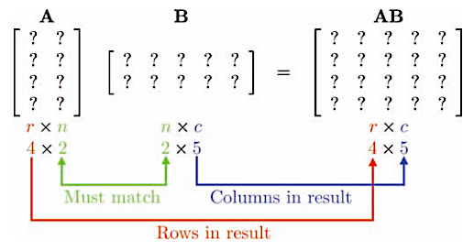
Matrix Multiplication Constraint
Matrices cannot be multiplied unless the number of columns of the first matrix matches the number of rows in the second matrix.

Slide 66

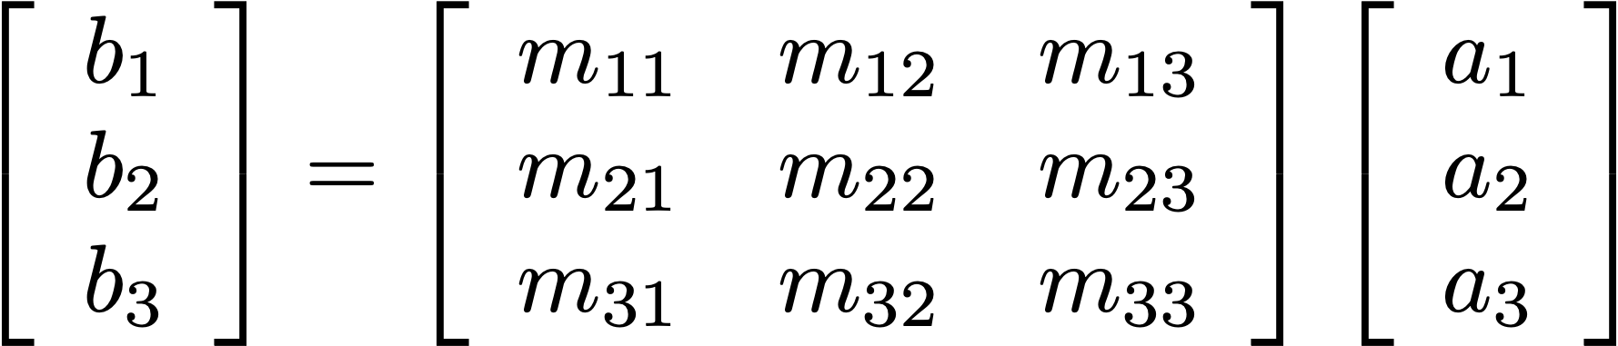
Multiplying by Vector
Multiplying a vector by a matrix is just a
compact way of writing a bunch of dot products

Slide 67
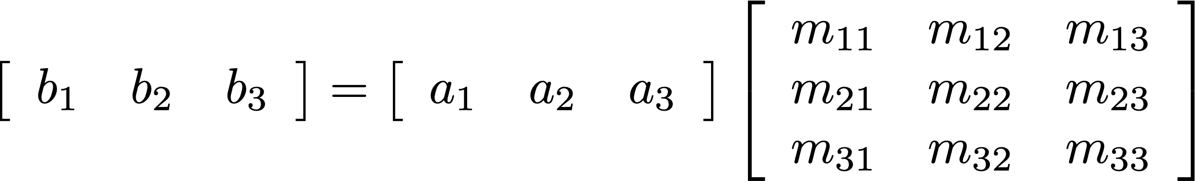
Row vs. Column
“column vector”
“row vectors”
“row vector”
“column vectors”

Slide 68
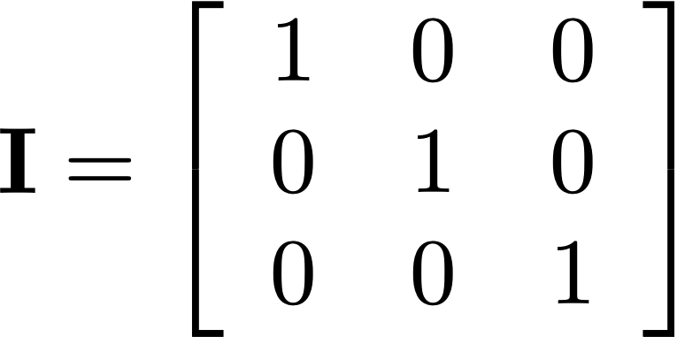

Identity Matrix

Slide 69
Matrix Inversion
Numpy: np.linalg.inv(m)
The inverse of a matrix is the matrix such that
inverse
There are multiple ways to compute the inverse
of a matrix, but we won’t cover that here

Slide 70
Coming up...
Transformations

